Slide 1
Presentation 25
Management and its role in
software quality assurance
The quality assurance organizational framework
Top management’s quality assurance activities
  Software quality policy
  The executive in charge of software quality
  Management review
Department management responsibilities for quality assurance processes
Project management responsibilities for quality assurance

Slide 2
The quality assurance
organizational framework
List of participants (“actors”)
List of participants (“actors”)
Managers
* Top management executives, especially the executive in charge of SQA
* Software development and maintenance department managers
* Software testing department managers
* Project managers and team leaders of development and maintenance projects
* Leaders of software testing teams
Testers
* Members of software testing teams
SQA professionals and interested practitioners
* SQA trustees
* SQA committee members
* SQA forum members
* SQA unit team members

Slide 3
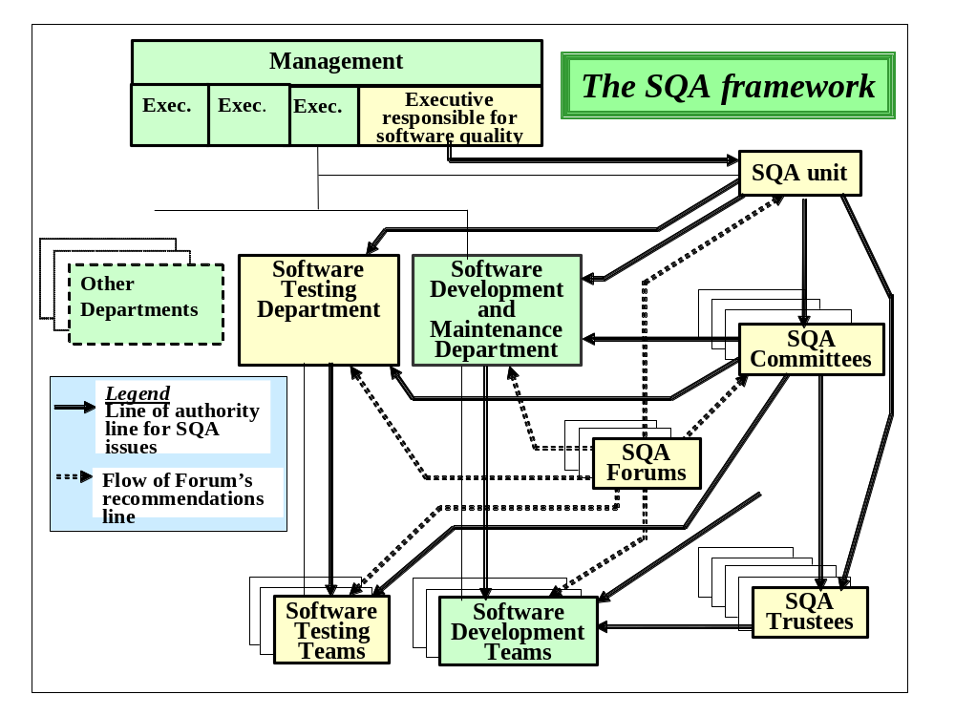

Slide 4
Top management's
overall responsibilities
for software quality
* Assure the quality of the Company’s software products and software maintenance services.
* Communicate the importance of product and service quality in addition to customer satisfaction to employees.
* Assure full compliance with customer requirements.
* Ensure that SQA objectives are established and accomplished.
* Initiate planning and oversee implementation of changes to adapt the SQA system to changes related to the organization's clientele, competition and technology.
* Intervene directly to resolve of crisis situations and minimize damages.
* Ensure availability of resources required by SQA systems.

Slide 5
Software quality
policy requirements
Conformity to the organization purpose and goals
Commitment to:
  * General software quality assurance concepts
  * The quality standards adopted by the organization
  * Allocate adequate resources for software quality assurance
  * Continuous improvement of the organizations quality and productivity

Slide 6
The responsibilities of
the executive in charge
of software quality
Responsibility for preparation of an annual SQA activities program and budget
Responsibility for preparation of SQA system development plans
Overall control of implementation of the annual SQA regular activities program and planned SQA development projects
Presentation and advocacy of SQA issues to executive management

Slide 7
Typical items contained
in management review reports
Management review is the name given to the periodic meeting convened to allow executives to obtain an overview of their organization’s software quality issues.
* Periodic performance reports, including quality metrics
* Customer satisfaction feedback
* Follow up reports for SQA annual regular activity program and SQA development projects
* Summary of special quality events related to customers, suppliers, subcontractors, etc.
* Review of significant findings of internal and external quality audits as well as special surveys
* Identification of new software quality risks and unsolved pre-existing risks
* Recommendations for software quality management improvements.

Slide 8
The main objectives of management reviews
The objectives of
management reviews
Assess achievement of quality objectives set for the organization’s software quality management system
Initiate updates and improvements of the software quality management system and its objectives
Outline directions for remedying major SQA deficiencies and software quality management problems.
Allocate additional resources to the software quality management system.

Slide 9
Department
management responsibilities
for quality assurance (1)
The quality system-related responsibilities
Preparation of the department’s annual SQA activities program and budget, based on recommended SQA unit program.
Preparation of the department’s SQA systems development plans, based on recommended SQA unit plan.
Control of performance of the department’s annual SQA activities program and development projects
Presentation of the department's SQA issues to the executive in charge of software quality.

Slide 10
Department
management responsibilities
for quality assurance (2)
Project-related responsibilities
Control of compliance to quality assurance procedures in the department's units, including CAB, SCM and SCCA bodies
Detailed follow up of contract review results and proposal approvals
Review of unit performance of planned review activities; approval of project documents and project phase completion
Follow up of software tests; approval of project’s software products.
Follow up of progress of software development project schedules and budget deviations. Advise and support project mangers in resolving difficulties.
Follow up of quality of maintenance services
Detailed follow up of project risks and their solutions
Follow up of project's compliance with customer requirements and customers satisfaction.
Approval of large software change orders and significant deviations from project specifications.

Slide 11
Project management
responsibilities for quality
assurance
Professional hands-on tasks:
Preparation of project and quality plans and their updates.
Participation in joint customer-supplier committee
Close follow up of project team staffing, including recruitment, training and instruction.
Management tasks The follow up issues:
* Performance of review activities and the consequent corrections, including participating in some reviews.
* Software development and maintenance units’ performance with respect to development, integration and system test activities, corrections and regression tests and acceptance tests
* Software installation in customer sites and the running-in of the software system by the customer
* SQA training and instruction of project team members
* Schedules and resources allocated to project activities.
* Customer requests and satisfaction
* Evolving project development risks, application of solutions and control of results.

